Slide 1

Justin Tawil Visual Resume
Mechanical Engineering Major, Robotics concentration

Slide 2
Work Experience

Slide 3

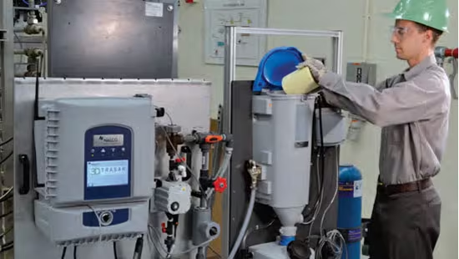
Nalco Water, an Ecolab Company (Summer 2023)
Traveled to several sites each day, performing chemical testing and service on HVAC systems and 3D Trasar controllers, identifying inefficiencies to recorrect systems according to local New York City laws, preventing $30,000 in violation costs
Helped downtown Manhattan district grow current annuity business, sent 26 3D Trasar controller upgrade proposals to customers, totaling ~$150,000 in continuous sales opportunities
Worked with customers to understand their technical support needs, maintaining relationships with over 100 building engineers

Slide 4
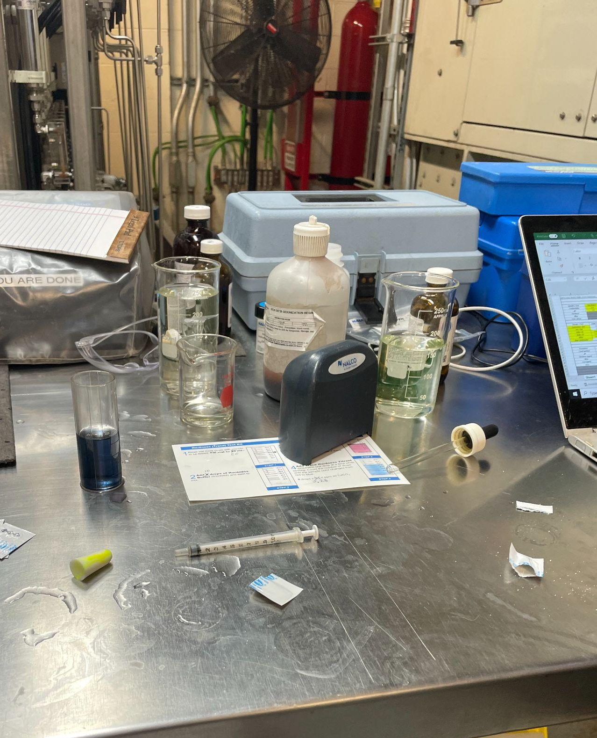
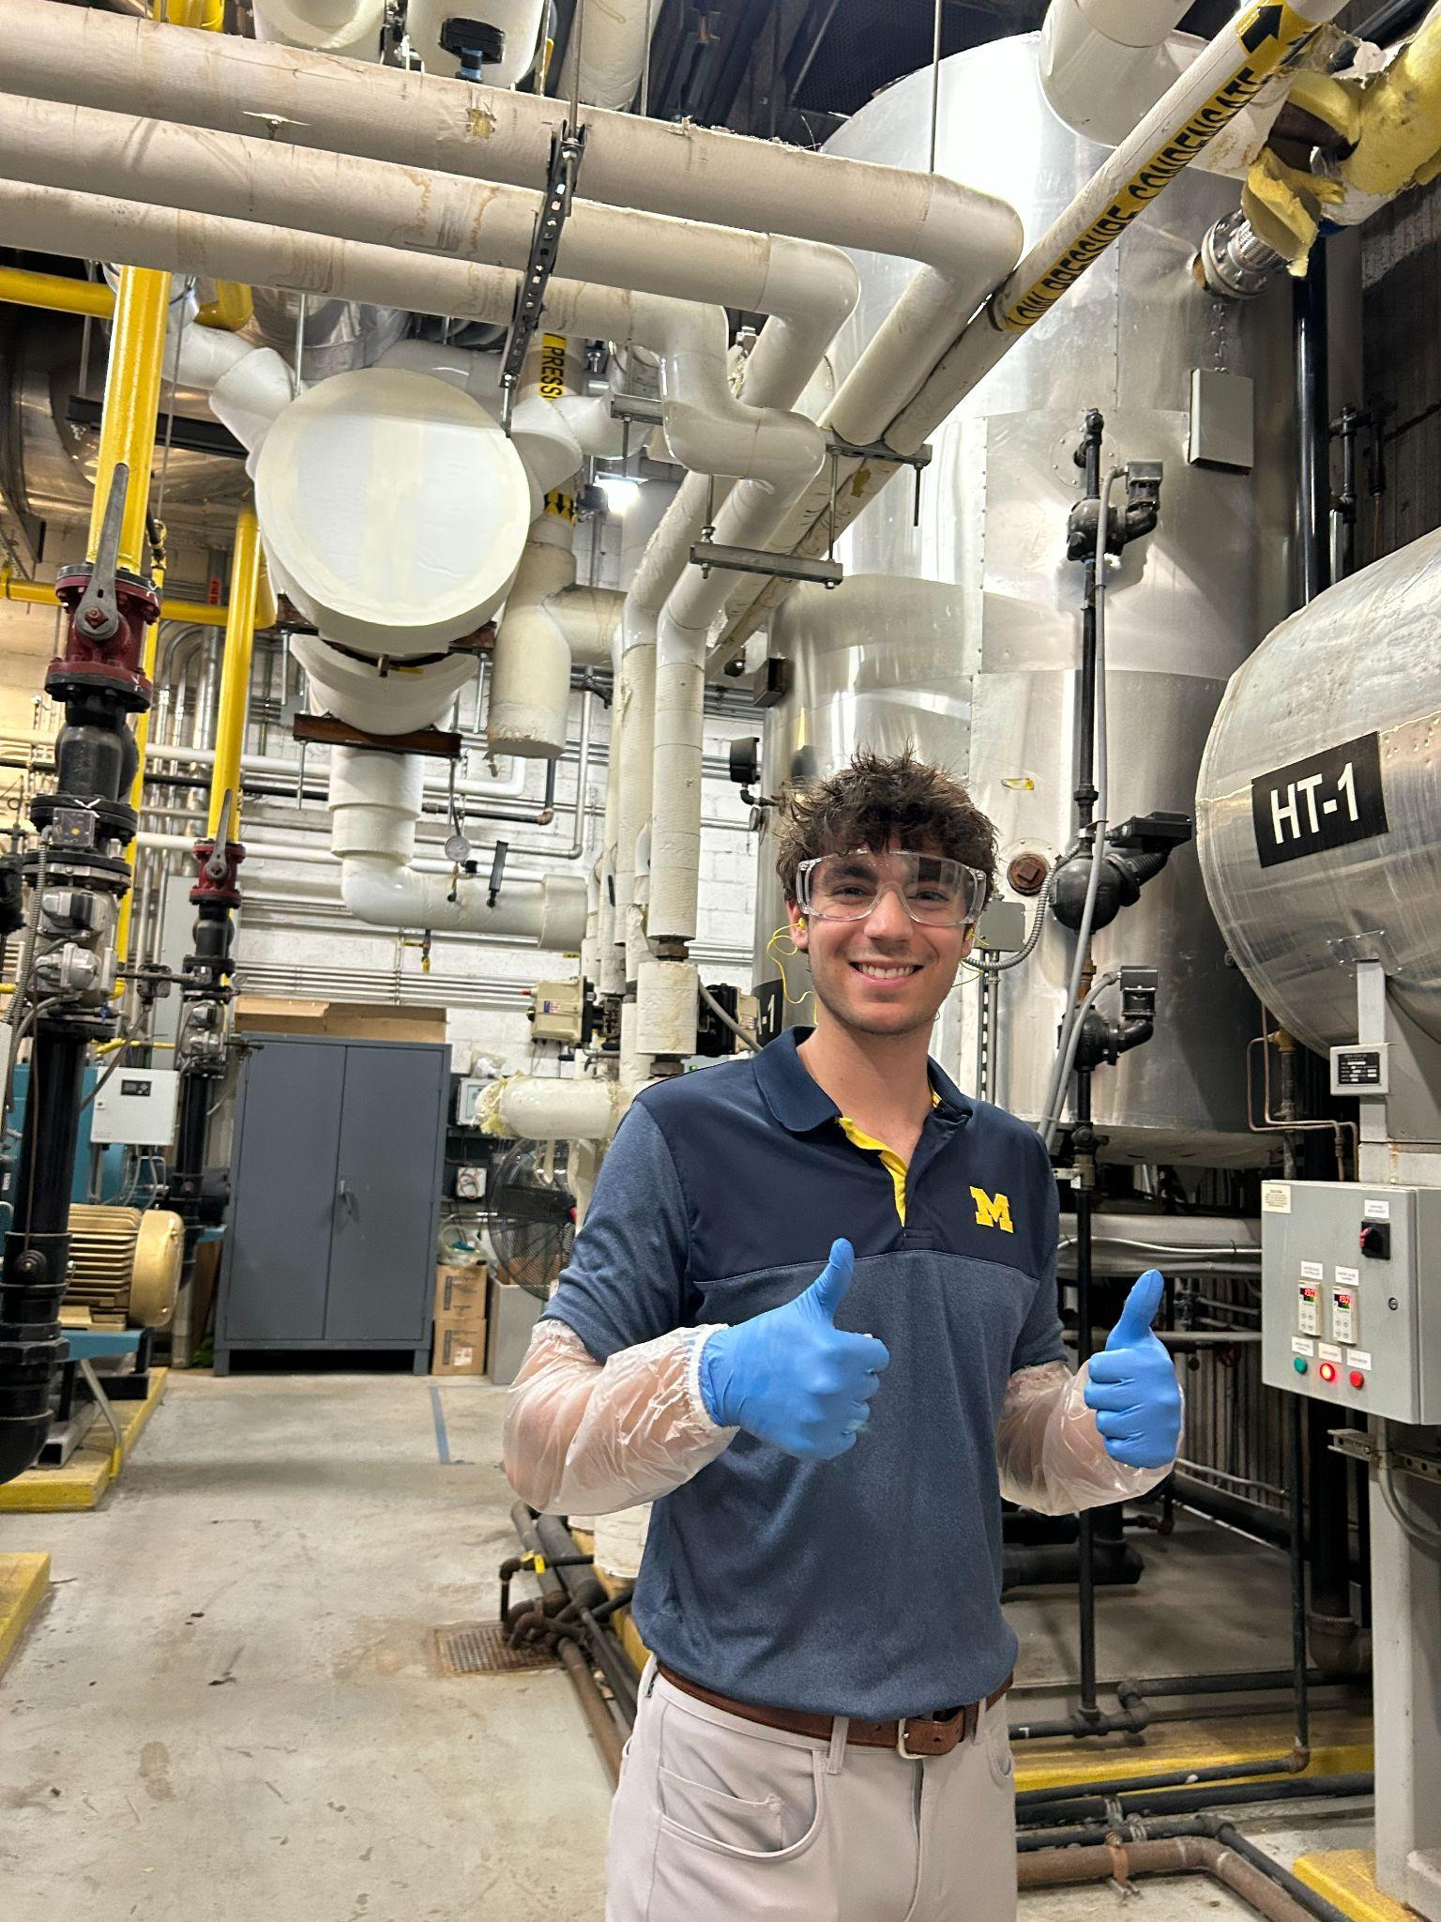
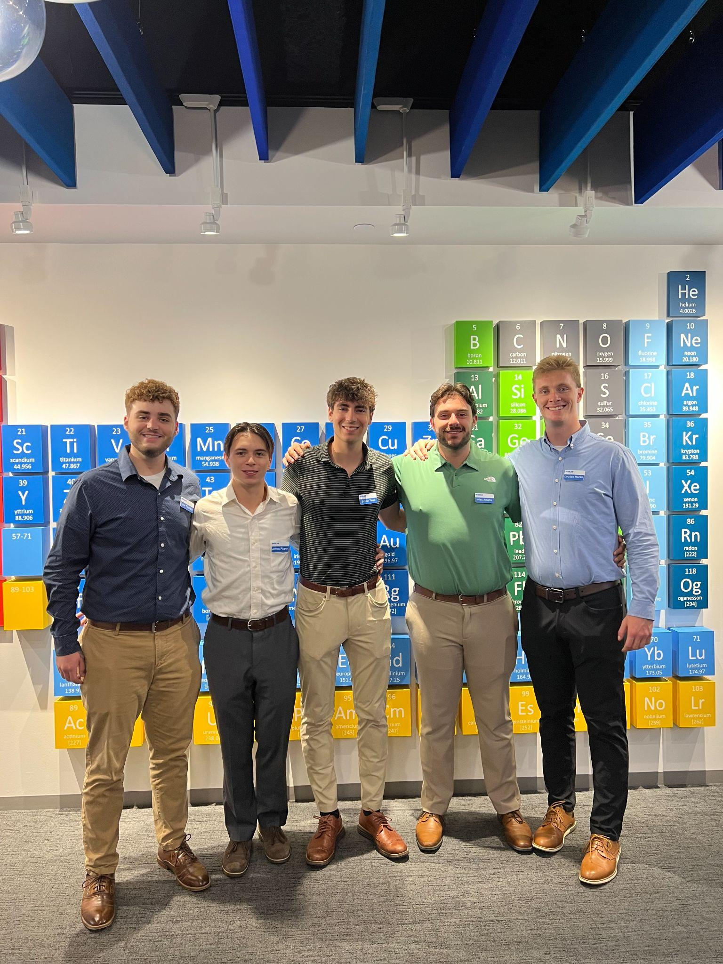
Nalco Water, cont.
Chemical testing at NYU Langone
With other interns at Nalco Headquarters in Naperville IL
Performing routine service at the Freedom Tower

Slide 5
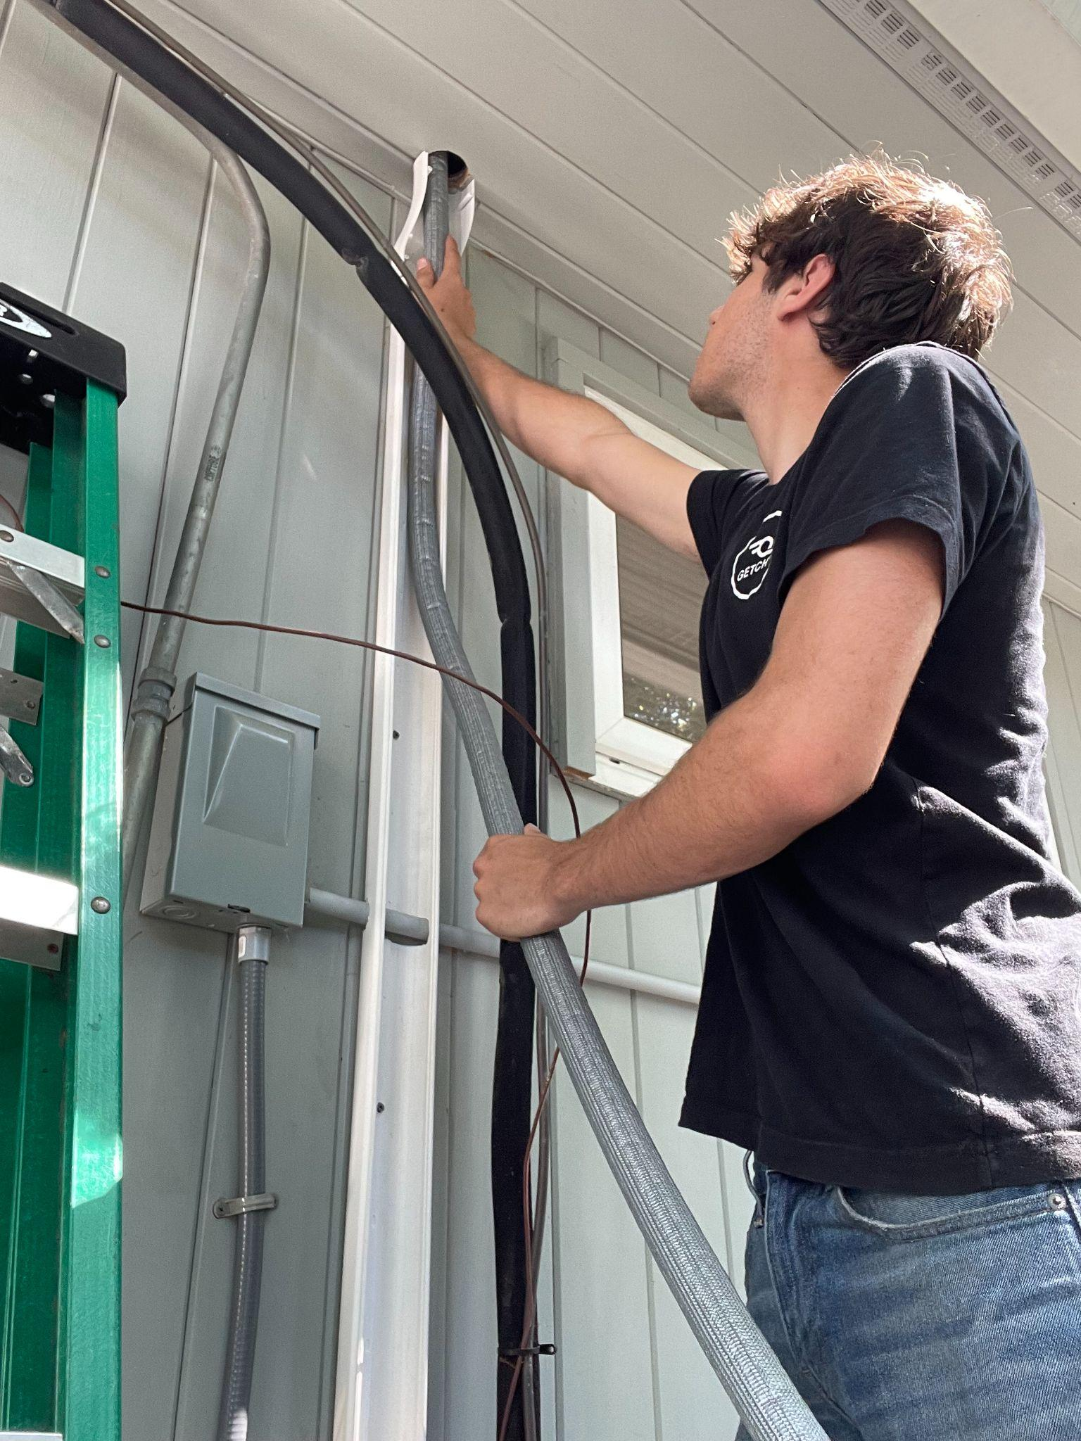
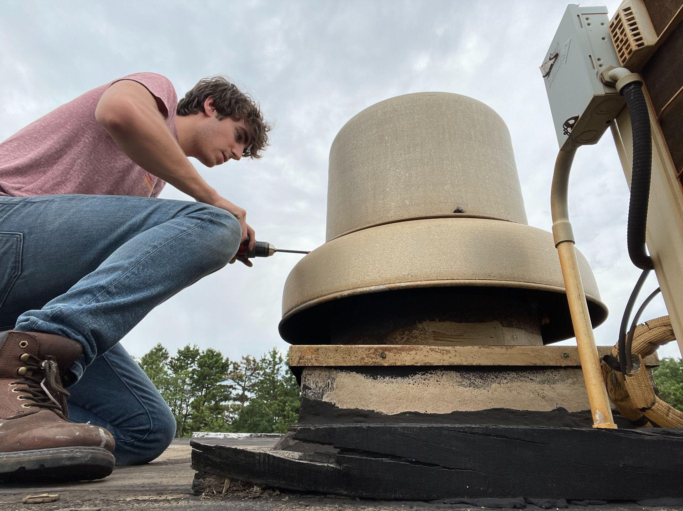
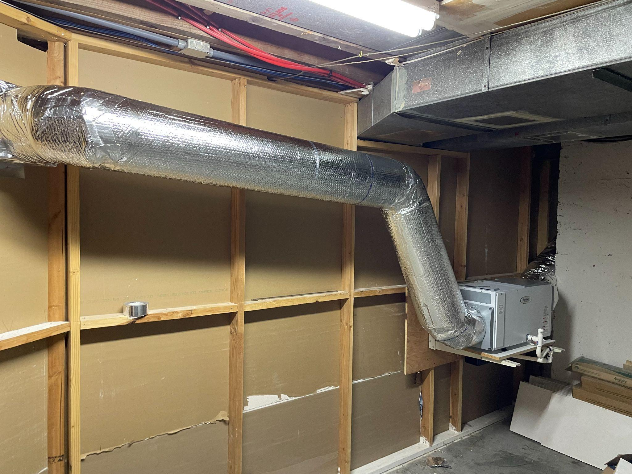
Meyer Mechanical Services (Summer 2022)
Performed hands on service for 1-5 customers per day, solving mechanical issues of thermodynamic systems including condensers, compressors, boilers, and dehumidifiers
Gathered data to assess potential mechanical issues, such as taking pressure readings, checking for leaks, rewiring electric components, to expedite service process
Installed several new HVAC systems, taking into account factors such as system placement, ventilation path, piping
Ventilation installed for HVAC System

Slide 6
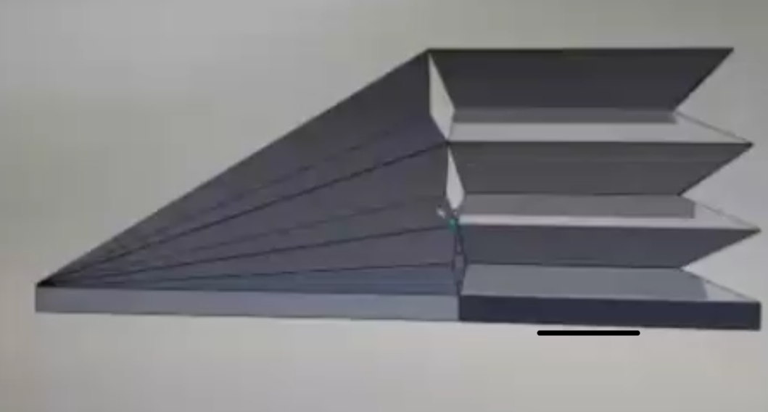
Capstone Design Project
Partnered with ASME and 5 peers to research and design an automatic accordion that plays when a MIDI file is read in
Tasked with following Michigan Mechanical Engineering specific design process and documenting it through several design review report and presentations
Utilized SolidWorks software to create accordion-bellow type mechanism
Accordion-bellow system that will be used to move air throughout the system

Slide 7
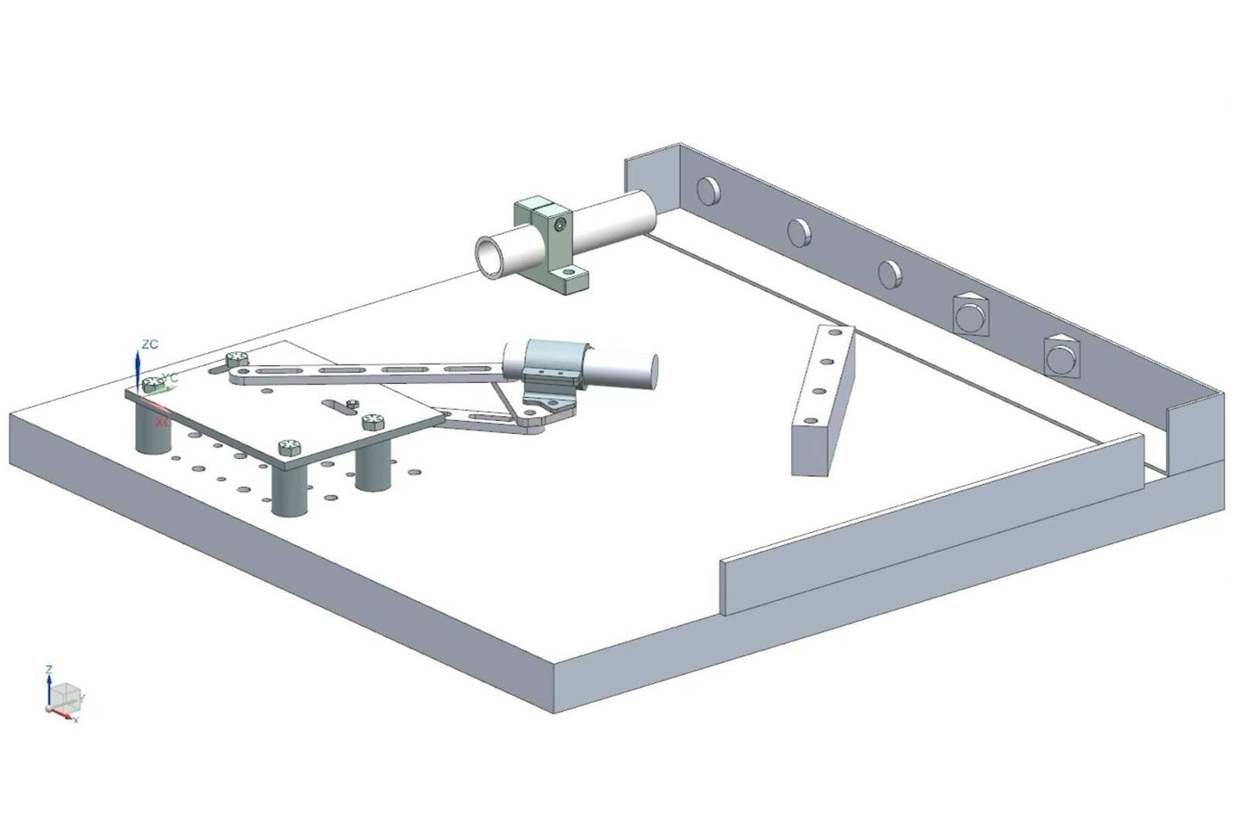
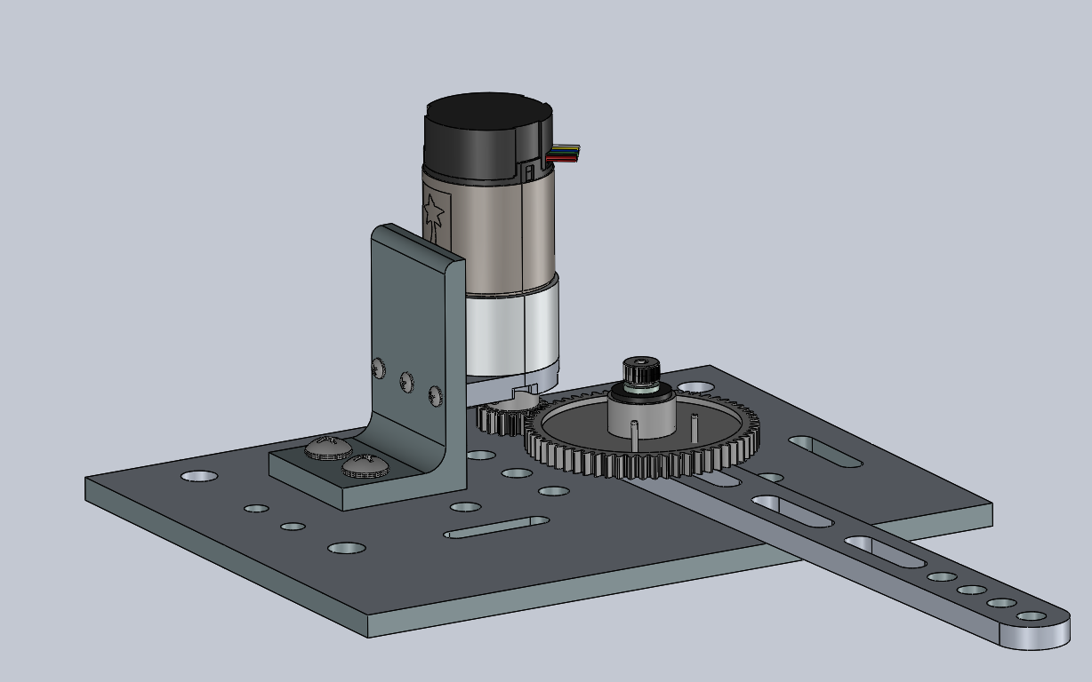
Design and Manufacturing: Linkage Project
Designed and manufactured a 4-bar linkage mechanism used to position and shine an LED onto photo sensors at different locations using custom PID software
Used dynamic simulation software, Adams, and inertia matching techniques to optimize transmission angle and gear ratio, maximizing energy transmission from the mechanism
Integrated PID control and sensors using an Arduino to automatically respond to flags being raised, shining an LED to a corresponding photosensor beneath it to drop it, successfully dropping 27 of 31 flags in 2 minutes
Pictured above is the CAD of the linkage system minus the transmission, which can be seen to the left

Slide 8

Linkage Project in action

Slide 9
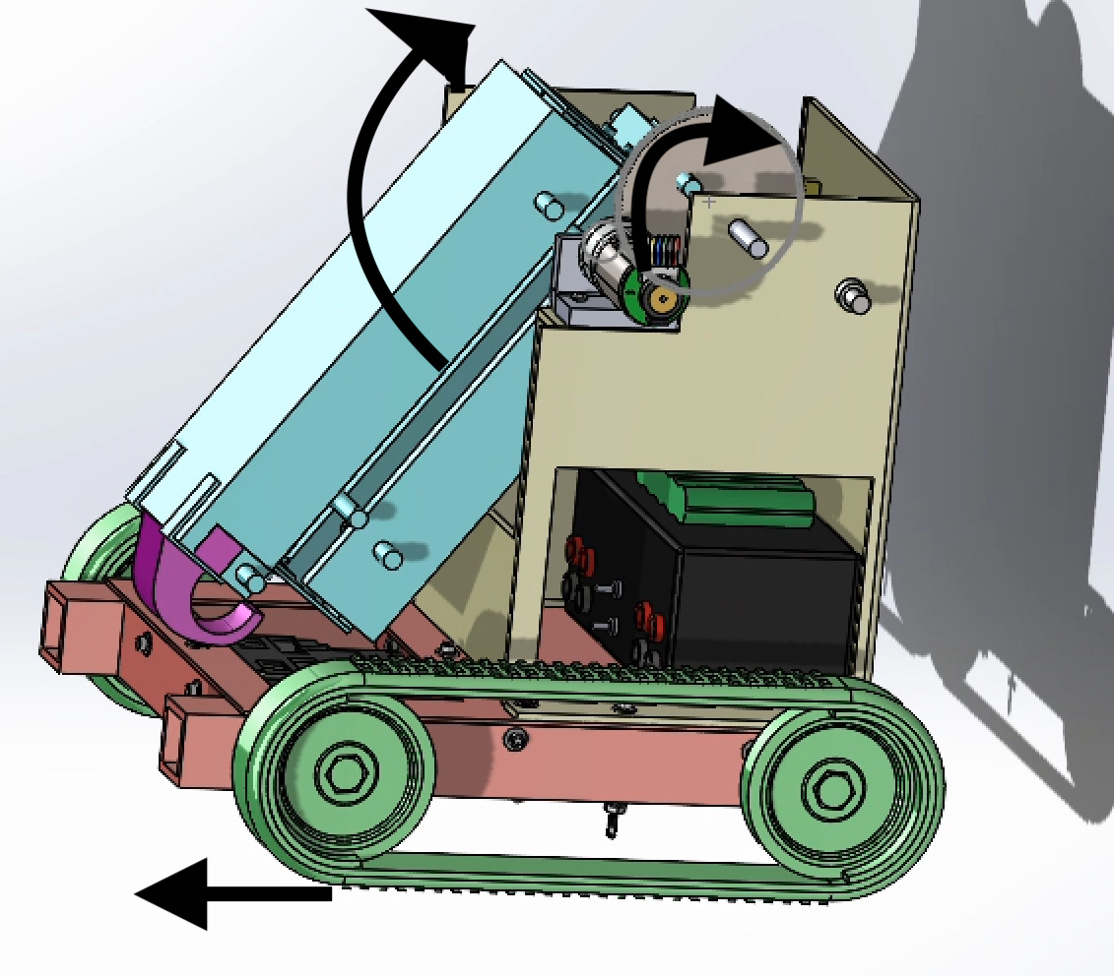
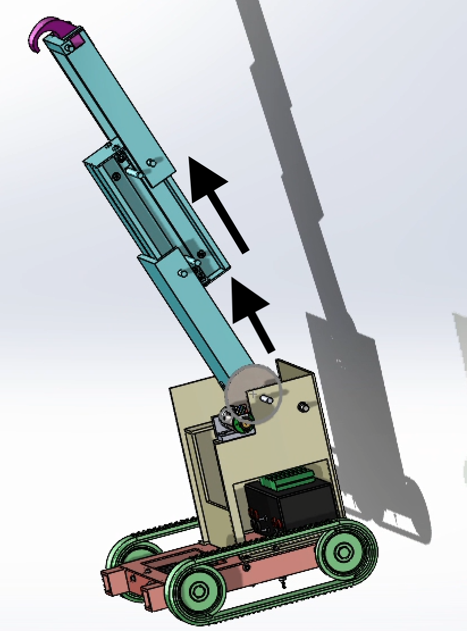
Design and Manufacturing: RMP Project
Designed a Robotic Mobility Platform through several levels of analysis, beginning with initial sketches, and then utilizing SolidWorks software to create full 3D assembly and engineering drawings
Created first principle analysis and empirical tests to optimize RMP functionality, leading to a lighter, faster, more precise design
Learned CNC machine skills while manufacturing RMP from given set of raw materials, achieving a final product that completed all necessary functional requirements
SolidWorks Model of our RMP

Slide 10
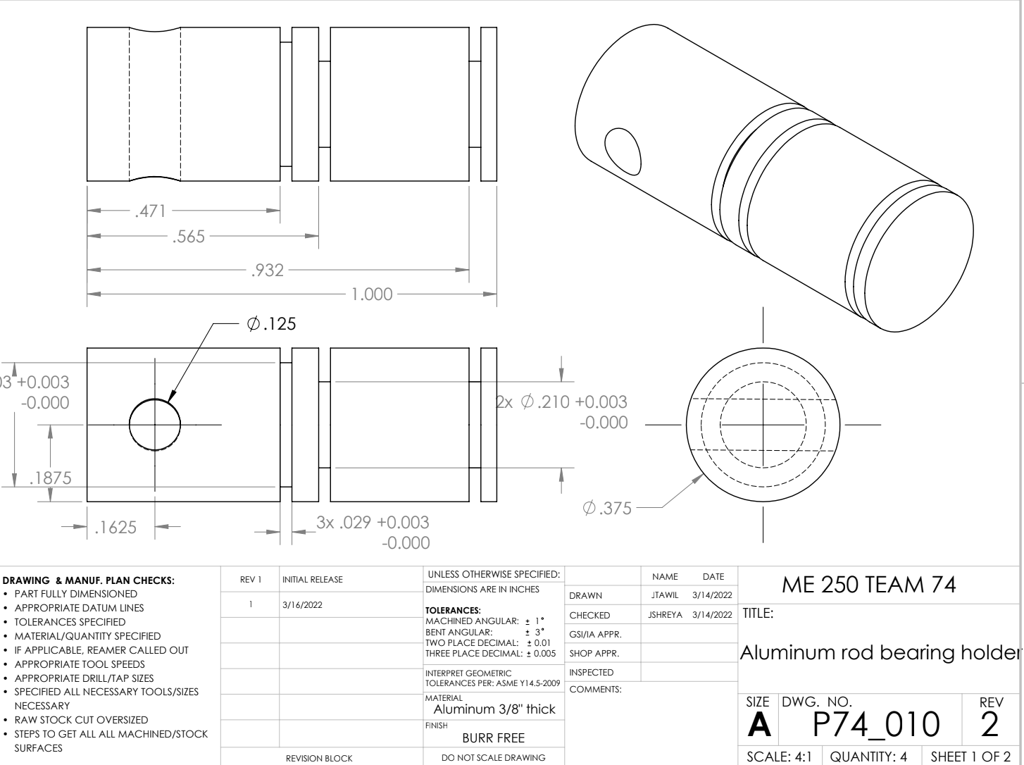
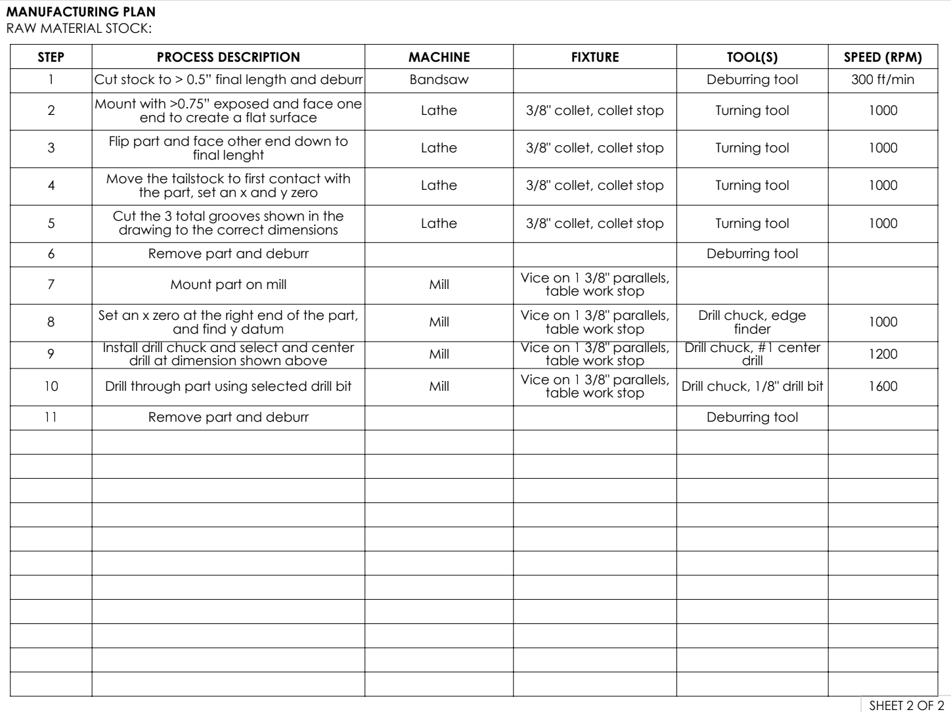
RMP Project cont.
Example Engineering Drawing and Manufacturing Plan

Slide 11
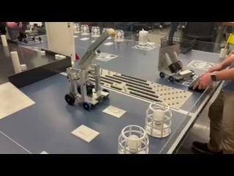
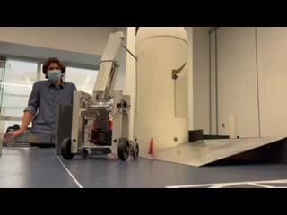
RMP Project in action

Slide 12
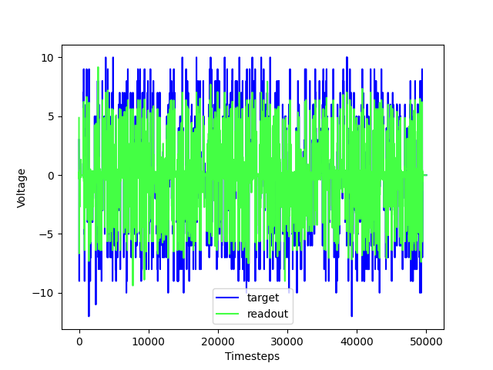
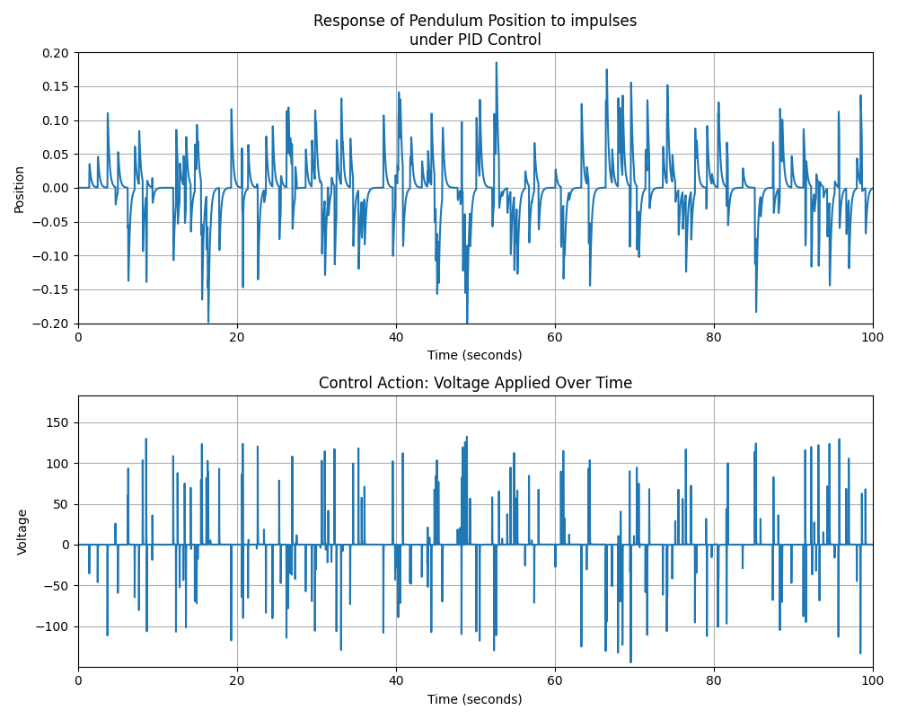
Mapleseed Autonomous Drone Team
Modeled and analyzed an inverted pendulum system to create a matlab script that simulates the response of the system using PID control, ultimately achieving an ideal response
Used data to train reservoir network to learn and predict PID controls for the inverted pendulum system

